Slide 1
H2T Electronic Store
Med-Fi Prototyping
Group 8

Slide 2
Table of contents
01
02
Low-fi revision
Med-fi prototypes

Slide 3
01
Low-fi
revision

Slide 4
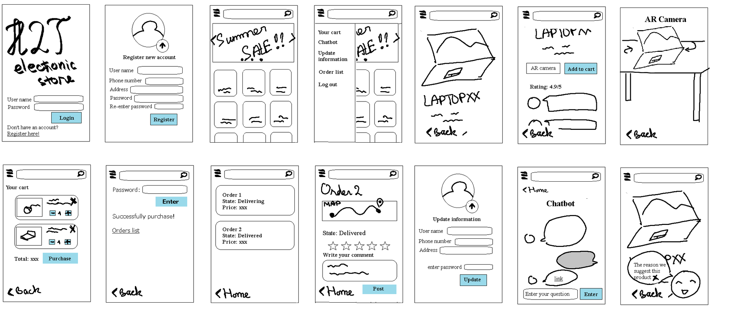
Low-Fi prototype constructions

Slide 5
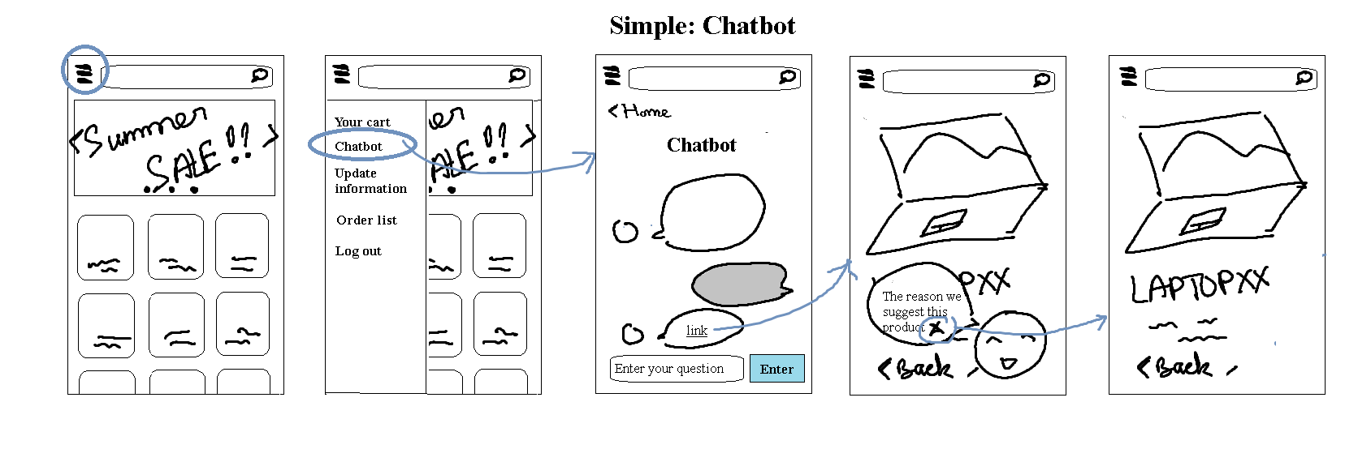
Simple: Chatbot

Slide 6
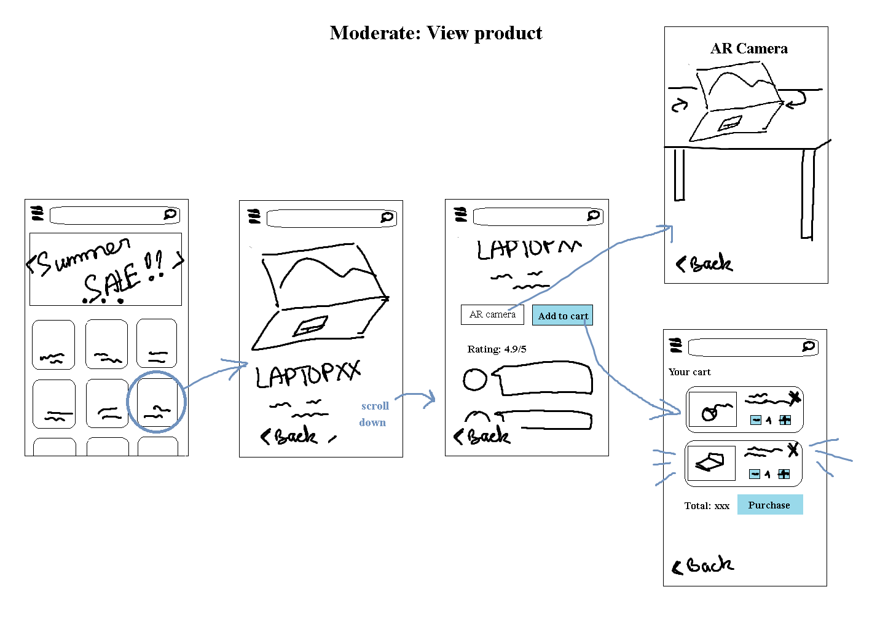
Moderate: View product

Slide 7
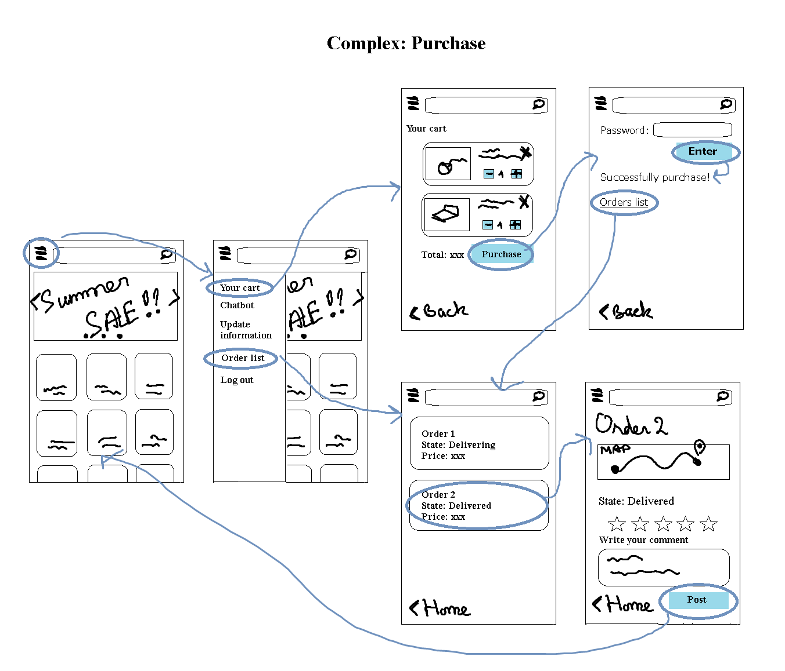
Complex: Purchase product

Slide 8
3 main adjustments
- Change the navigate bar from list to icons in the lowest bar
- Adding account page
- Adding forget password choice

Slide 9
02
Med-fi prototypes

Slide 10
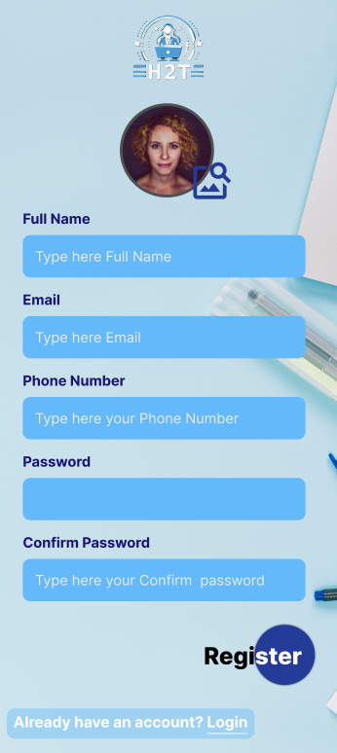

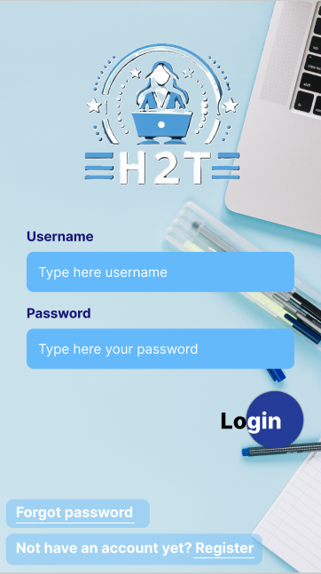
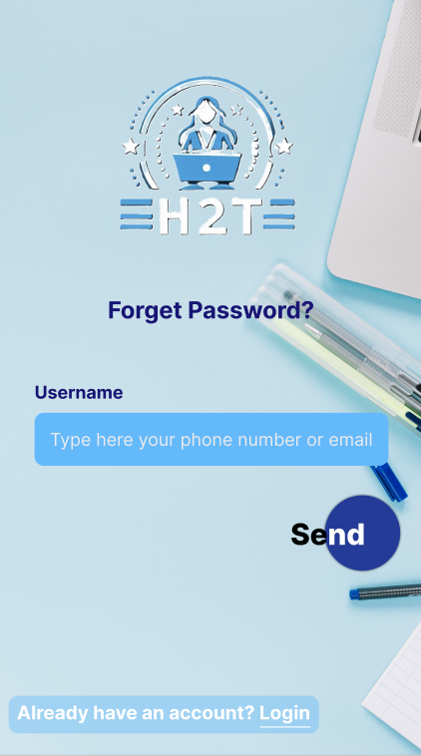

Med-Fi prototype constructions

Slide 11
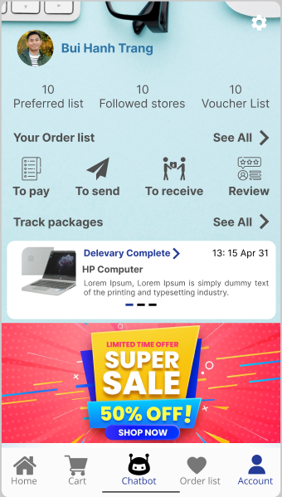
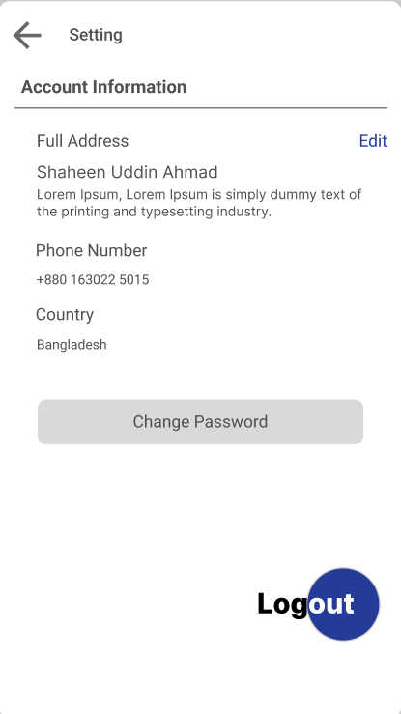
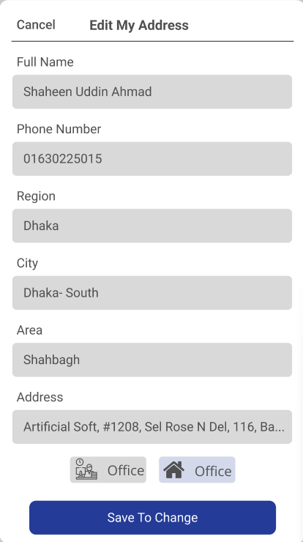
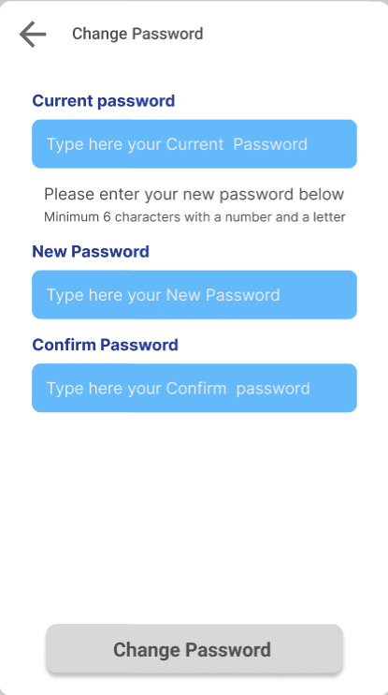
Med-Fi prototype constructions

Slide 12
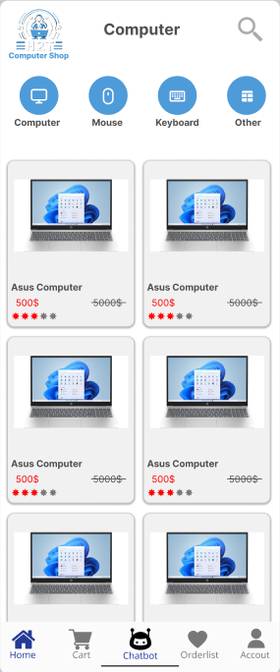
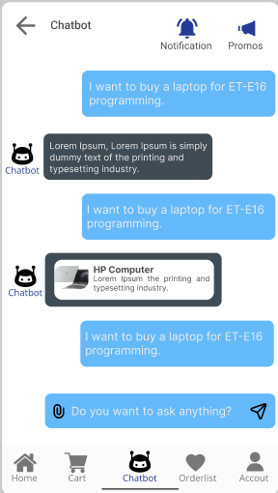
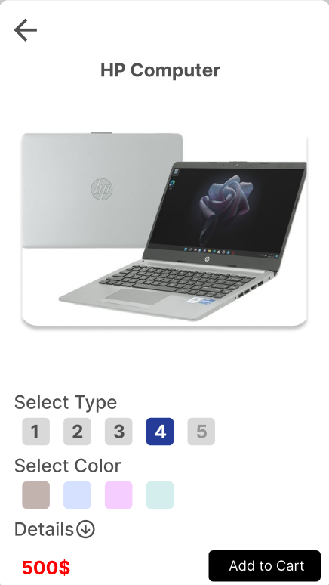
Simple: Chatbot

Slide 13
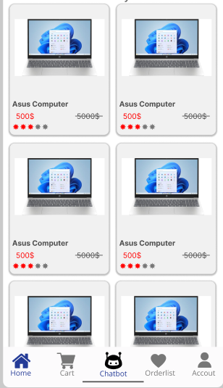

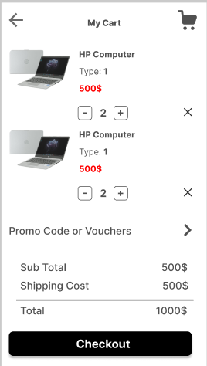
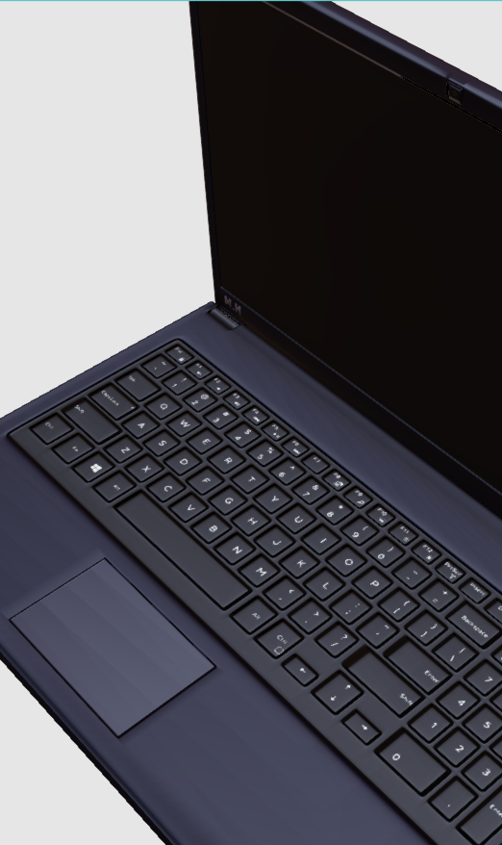
Moderate: View product

Slide 14
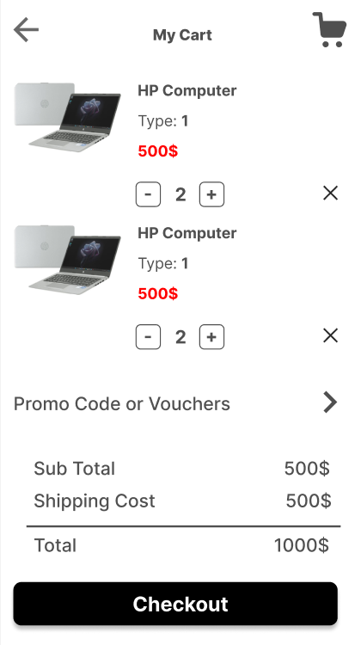
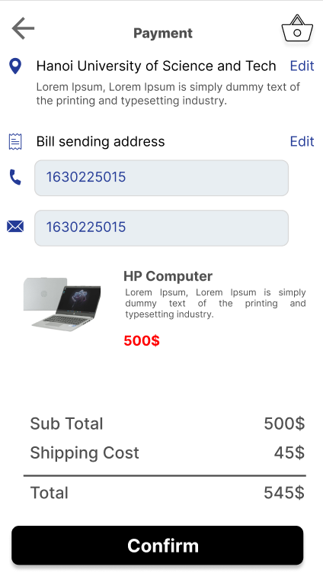
Complex: Purchase product

